Slide 1
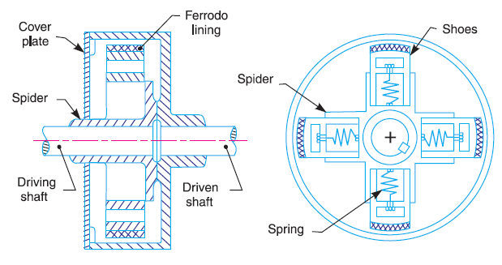
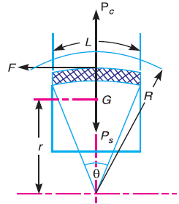
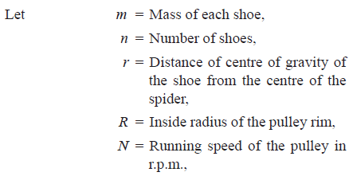
Theory of machines Wessam Al Azzawi
Friction:
Centrifugal clutch
Centrifugal clutch
The centrifugal clutches are used on the motor pulleys. It consists of a number of shoes on the inside of a rim of the pulley, as shown in Fig.
To determine the mass of the shoes

Slide 2
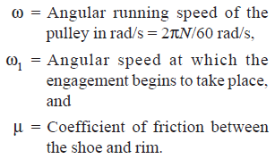
Theory of machines Wessam Al Azzawi
Friction:
Centrifugal force acting on each shoe:
P_{c} = m.ω².r
Inward force on each shoe exerted by the spring:
P_{s} = m (ω₁)² r
The net outward radial force with which the shoe presses against the rim:
= P_{c} – P_{s}
the frictional force acting tangentially on each shoe:
F = μ (P_{c} – P_{s})
Frictional torque acting on each shoe:
= F × R = μ (P_{c} – P_{s}) R
Total frictional torque:
T = μ (P_{c} – P_{s}) R × n = n.F.R (Find the mass)

Slide 3
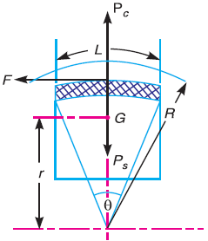
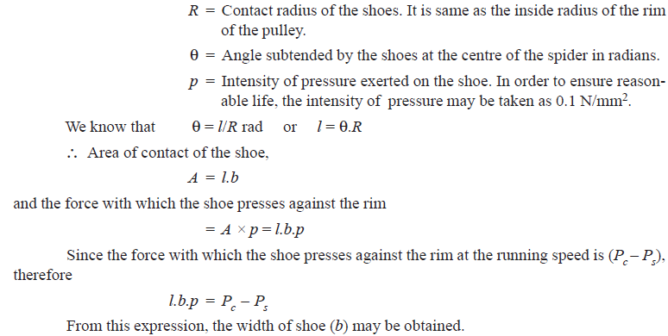
Theory of machines Wessam Al Azzawi
To determine the Size of the shoes
Let l = Contact length of the shoes,
b = Width of the shoes,

Slide 4
Theory of machines Wessam Al Azzawi
Friction:
Example. A centrifugal clutch is to transmit 15 kW at 900 r.p.m. The shoes are four in number. The speed at which the engagement begins is 3/4th of the running speed. The inside radius of the pulley rim is 150 mm and the centre of gravity of the shoe lies at 120 mm from the centre of the spider. The shoes are lined with Ferrodo for which the coefficient of friction may be taken as 0.25. Determine : 1. Mass of the shoes, and 2. Size of the shoes, if angle subtended by the shoes at the centre of the spider is 60º and the pressure exerted on the shoes is 0.1 N/mm2.

Slide 5
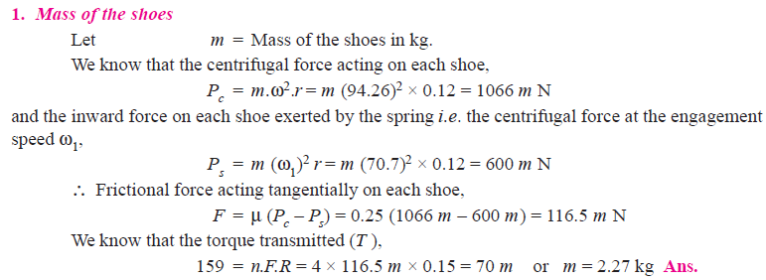
Theory of machines Wessam Al Azzawi
Friction:

Slide 6
Theory of machines Wessam Al Azzawi
Friction:

Slide 7
Theory of machines Wessam Al Azzawi
Friction:

Slide 8
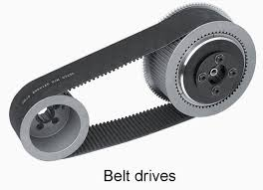
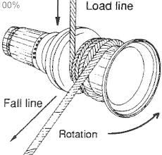
Theory of machines Wessam Al Azzawi
Friction:
Belt and Rope Drives
Used to transmit power, the power depends on:
Velocity of the belt
The tension of the belt
Contact arc between the belt and smaller pulley
The conditions of the belt:
Shafts should be parallel to insure uniform tension across the belt section
Pulleys should not be too close together, the arc of contact on the smaller pulley should be as large as possible.
Pulleys are not so far, heavy belt increases friction on the bearings
long belt tends to swing from side to side
Tight side should be at the bottom, so that sag in the loose side will increase the arc.
For flat belts, the maximum distance between shafts should not exceed 10 m and the minimum should not be less than 3.5 times the diameter of the larger pulley.

Slide 9
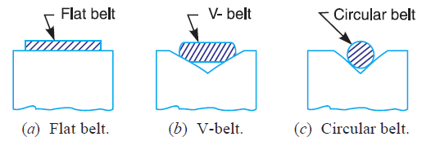
Theory of machines Wessam Al Azzawi
Friction:
Types of Belts
Flat belt, used in the factories and workshops, pulleys are not more than 8 meters apart.
V-belt, factories and workshops, pulleys are very near to each other
Circular belt or rope, used in the factories and workshops, pulleys are more than 8 meters apart.
For huge amount of power, single belt may not be enough. A wide pulleys with a number of grooves are used.

Slide 10
Theory of machines Wessam Al Azzawi
Friction:
Velocity ratio
It is the ratio between the velocities of the driver and the follower or driven.
Let d₁ = Diameter of the driver,
d₂ = Diameter of the follower,
N₁ = Speed of the driver in r.p.m., and
N₂ = Speed of the follower in r.p.m.
∴ Length of the belt that passes over the driver, in one minute
= π d₁.N₁
Similarly, length of the belt that passes over the follower = π d₂ . N₂
π d₁.N₁ = π d₂ . N₂ →
If thickness of the belt (t) is considered, then velocity ratio,

Slide 11
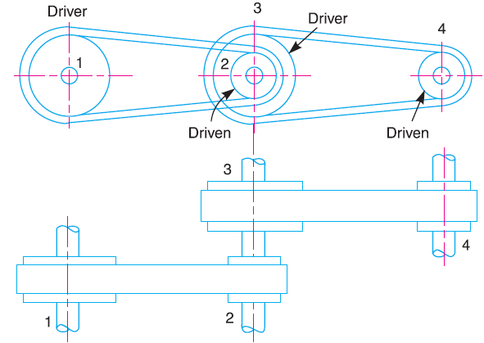
Theory of machines Wessam Al Azzawi
Friction:
Velocity Ratio of a Compound Belt Drive
Sometimes the power is transmitted from one shaft to another, through a number of pulleys as shown in Fig.

Slide 12
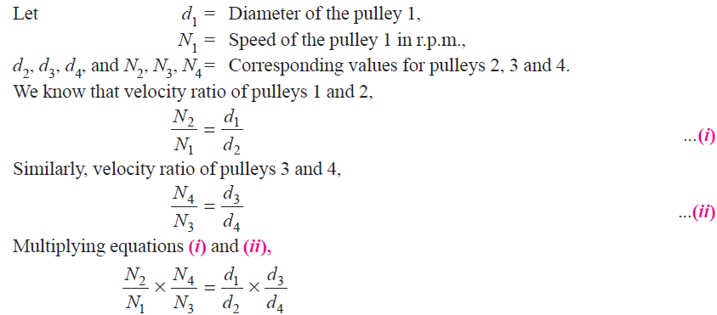
Theory of machines Wessam Al Azzawi
Friction:
Velocity Ratio of a Compound Belt Drive
Consider a pulley 1 driving the pulley 2. Since the pulleys 2 and 3 are keyed to the same shaft, therefore the pulley 1 also drives the pulley 3 which, in turn, drives the pulley 4.

Slide 13
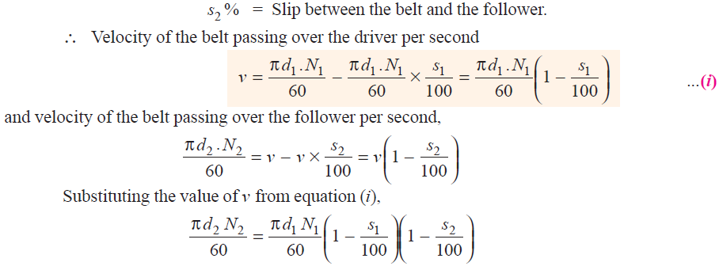
Theory of machines Wessam Al Azzawi
Friction:
Slip of Belt
In the previous study we assumed a firm frictional grip between the belts and the shafts. But sometimes, the frictional grip becomes insufficient. This may cause forward motion of the driver without carrying the belt. This also cause some forward motion of the belt without carrying the driven pulley with it. This is called slip of the belt.
Let s1 % = Slip between the driver and the belt

Slide 14
Theory of machines Wessam Al Azzawi
Friction:
Slip of Belt

Slide 15
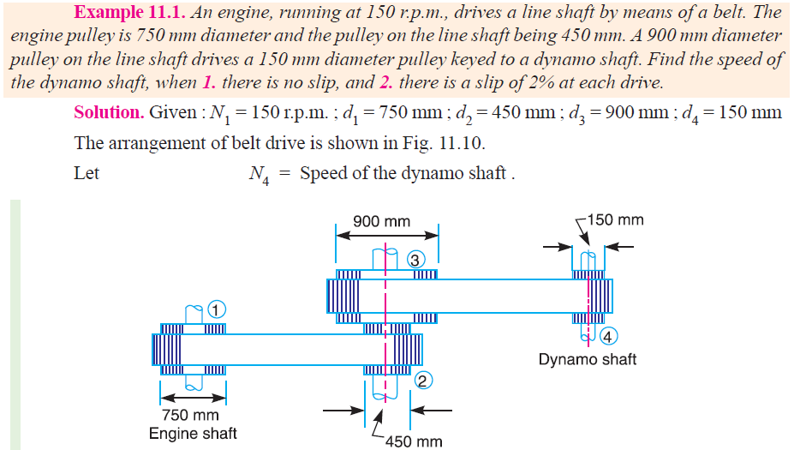
Theory of machines Wessam Al Azzawi
Friction:
Slip of Belt

Slide 16
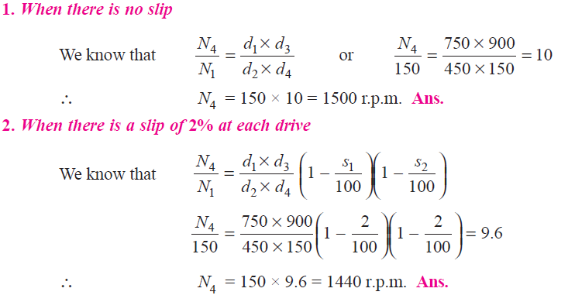
Theory of machines Wessam Al Azzawi
Friction:
Slip of Belt

